Slide 1
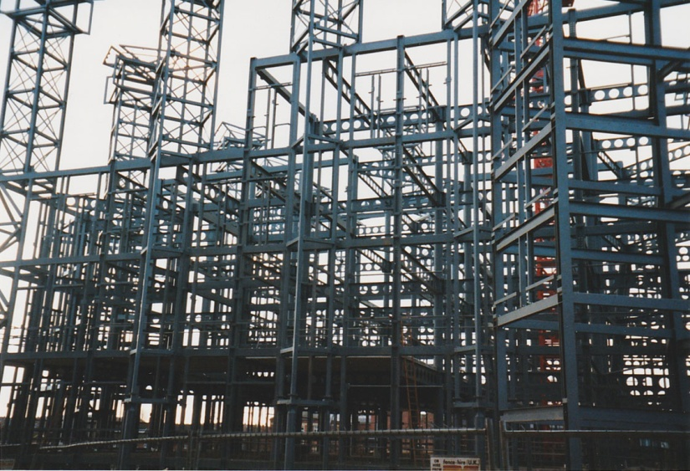
FIGURE 30.1 A Substantial Steel Frame for a Library That has High Loadings From the Books
Copyright © 2016 Elsevier Ltd. All rights reserved.

Slide 2
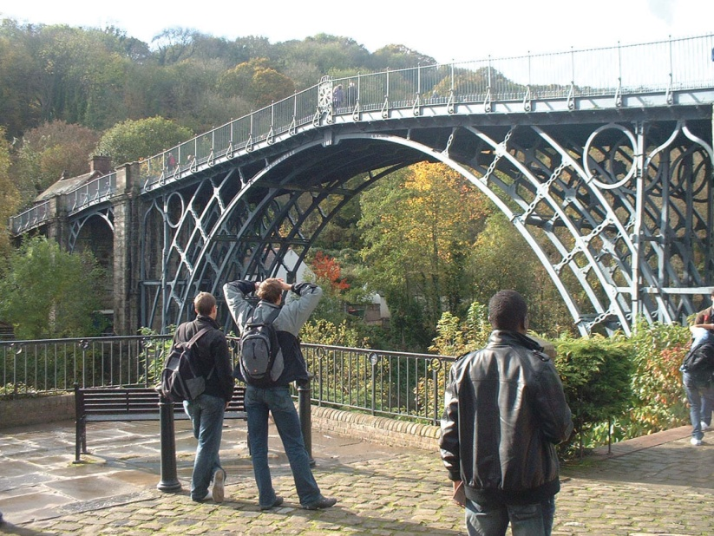
FIGURE 30.2 Students Admiring the World’s First Iron Bridge, Which was Built in 1779, Spanning the River
Severn in England
Copyright © 2016 Elsevier Ltd. All rights reserved.

Slide 3
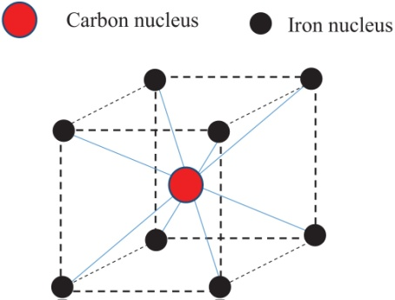
FIGURE 30.3 Body Centred Cubic Crystal
Cell
Copyright © 2016 Elsevier Ltd. All rights reserved.

Slide 4
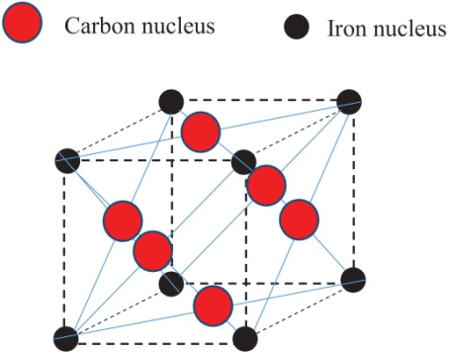
FIGURE 30.4 Face Centred Crystal Cell
Copyright © 2016 Elsevier Ltd. All rights reserved.

Slide 5
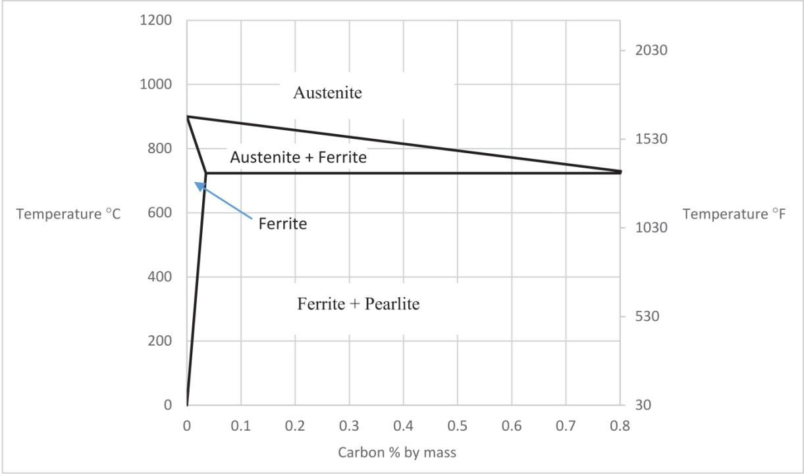
FIGURE 30.5 Part of the Iron–Carbon Constitutional Diagram
Copyright © 2016 Elsevier Ltd. All rights reserved.

Slide 6
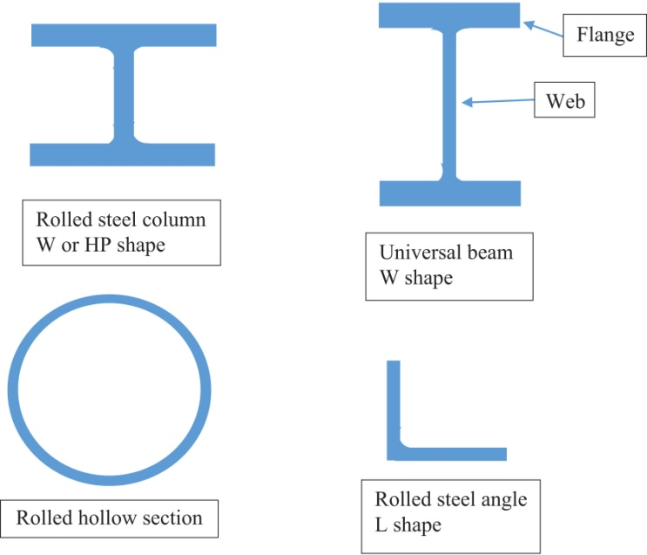
FIGURE 30.6 Some Common Rolled Sections
Copyright © 2016 Elsevier Ltd. All rights reserved.

Slide 7
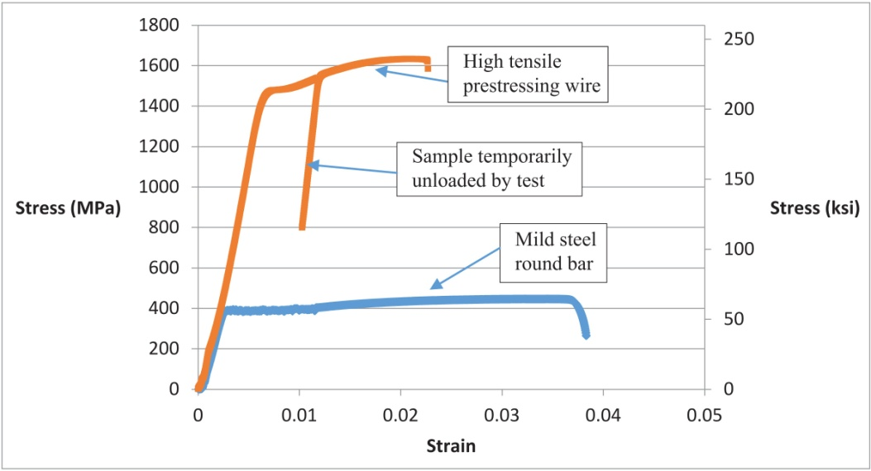
FIGURE 30.7 Stress–Strain Data for Two Different Steels
Copyright © 2016 Elsevier Ltd. All rights reserved.

Slide 8
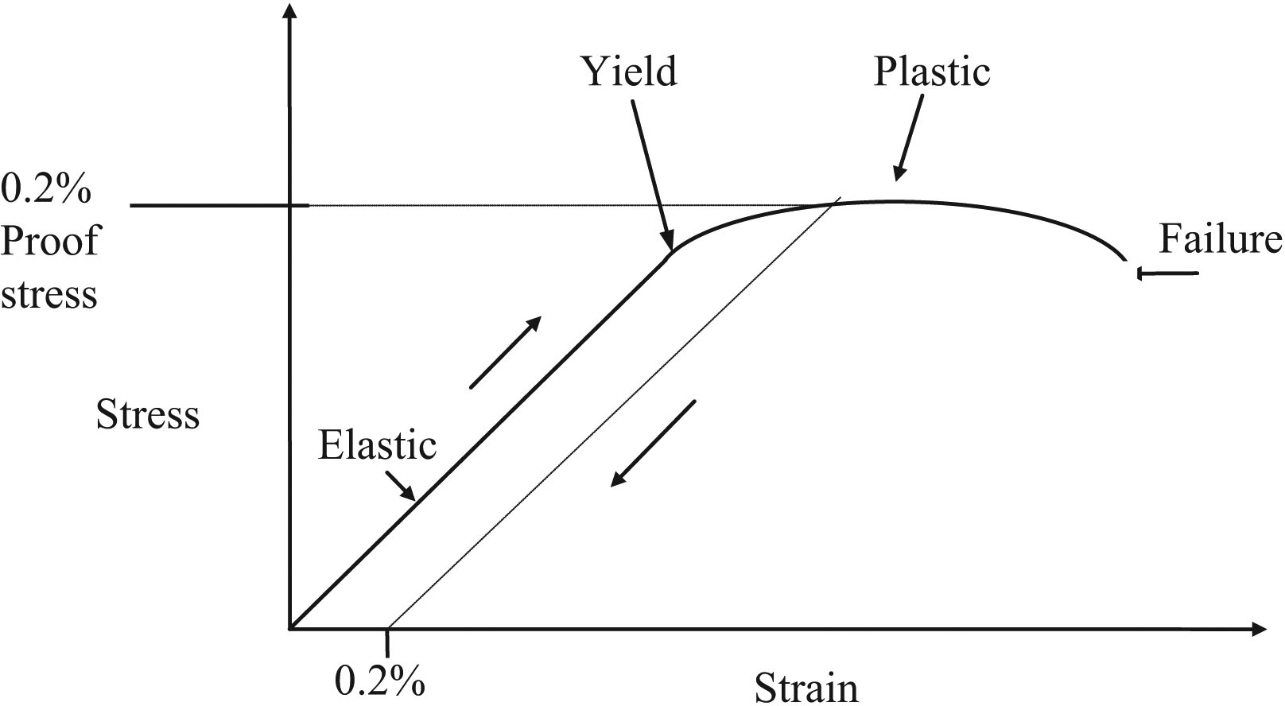
FIGURE 30.8 The 0.2% Proof Stress
Copyright © 2016 Elsevier Ltd. All rights reserved.

Slide 9
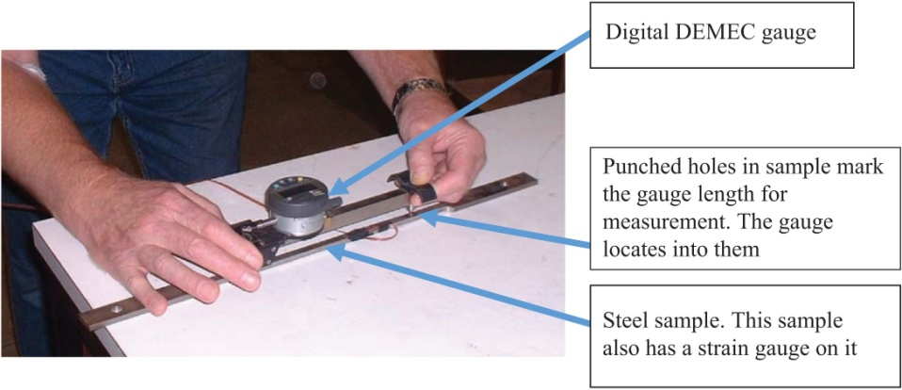
FIGURE 30.9 Measuring Extension of a Steel Sample With a “Digital DEMEC Gauge”
Copyright © 2016 Elsevier Ltd. All rights reserved.

Slide 10
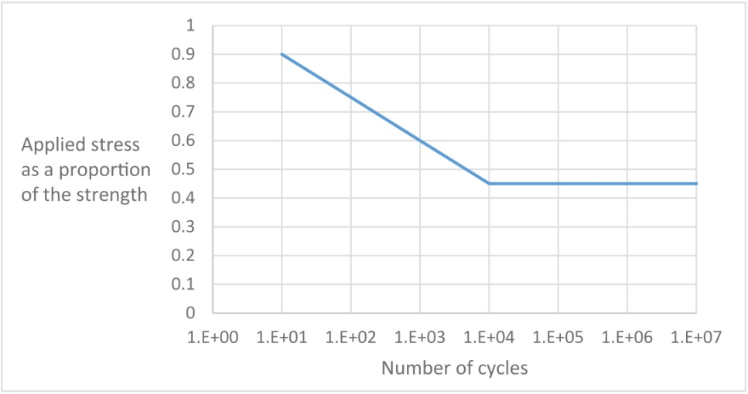
FIGURE 30.10 Schematic Graph of Fatigue Failure Loads
Copyright © 2016 Elsevier Ltd. All rights reserved.

Slide 11
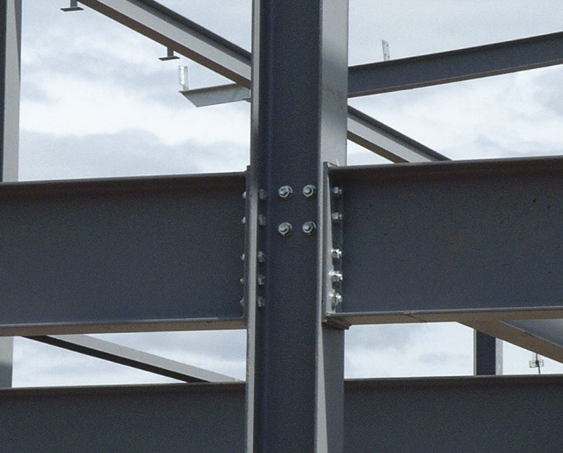
FIGURE 30.11 A Typical Bolted Joint in a Steel Frame
Copyright © 2016 Elsevier Ltd. All rights reserved.

Slide 12
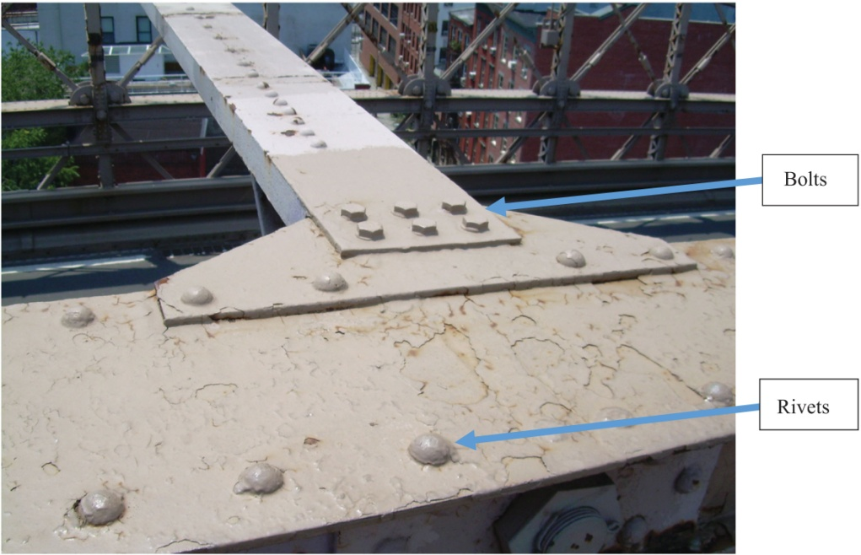
FIGURE 30.12 Bolts and Rivets on the Brooklyn Bridge in New York
Copyright © 2016 Elsevier Ltd. All rights reserved.

Slide 13
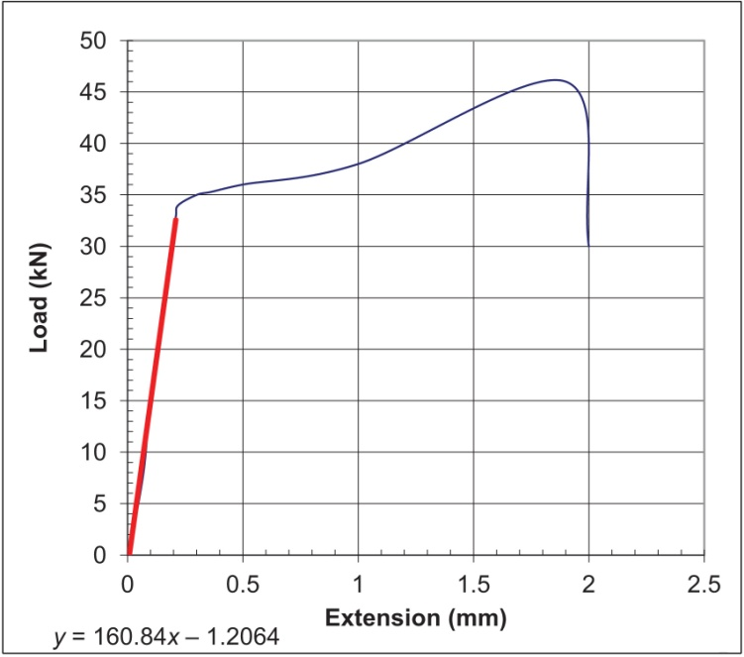
Copyright © 2016 Elsevier Ltd. All rights reserved.

Slide 14
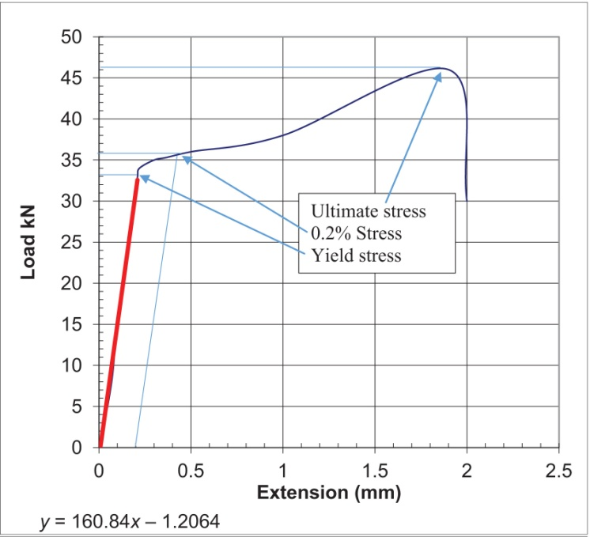
Copyright © 2016 Elsevier Ltd. All rights reserved.

Slide 15
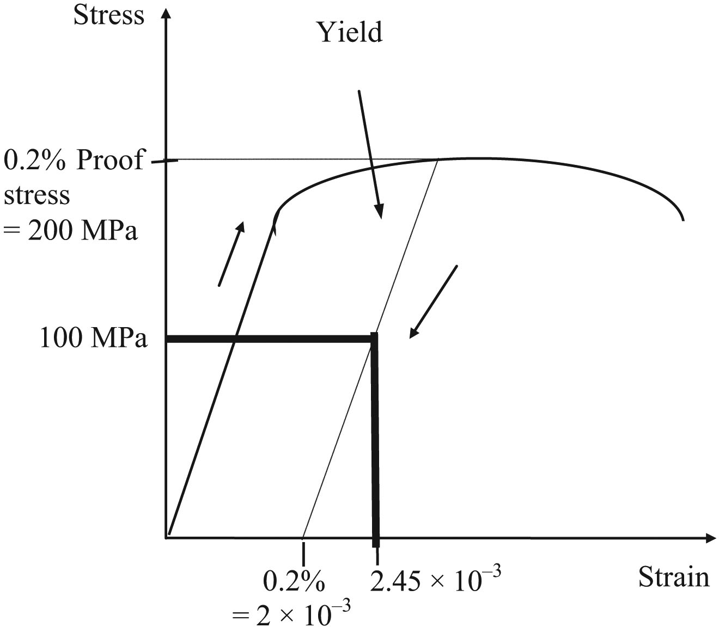
Copyright © 2016 Elsevier Ltd. All rights reserved.

Slide 16
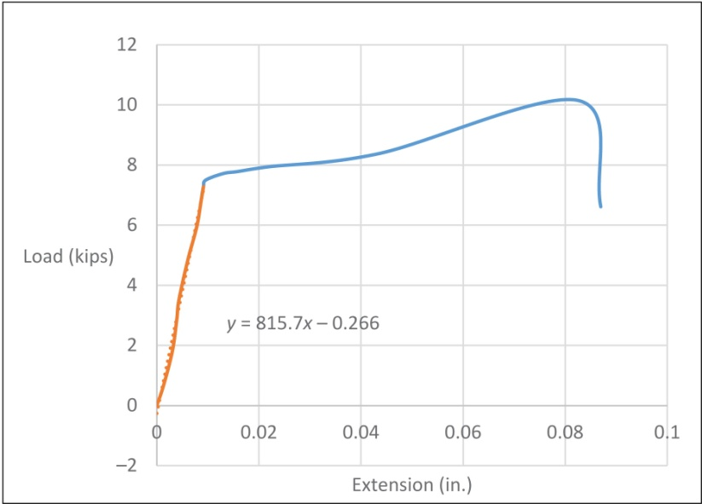
Copyright © 2016 Elsevier Ltd. All rights reserved.

